Slide 1
25
Production and Growth
P R I N C I P L E S O F
F O U R T H E D I T I O N
Notes:
This chapter covers a very important topic, one that many students find compelling.
The 4th edition adds several new “In the News” boxes, and I think you and your students will find them very interesting. The 4th edition also adds a new diagram of the production function in “per-worker” terms (Figure 25-1). This diagram makes it easy to see the impact of diminishing returns to capital and implications for the catch-up effect.
This is one of the less challenging chapters in the book. Therefore, if you’re running short on time, you can probably do the following safely:
1) Cover much of the material (especially the chapter’s first section) at a somewhat faster pace than you cover other chapters.
2) Make your students bear a larger than normal share of the burden of learning the material. For example, in the third major section (“Economic Growth and Public Policy”), you can choose one or more subsections to have students read on their own. You can probably safely assign some or all of the “In the News” boxes as out-of-class reading.

Slide 2
In this chapter, look for the answers to these questions:
What are the facts about living standards and growth rates around the world?
Why does productivity matter for living standards?
What determines productivity and its growth rate?
How can public policy affect growth and living standards?

Slide 3
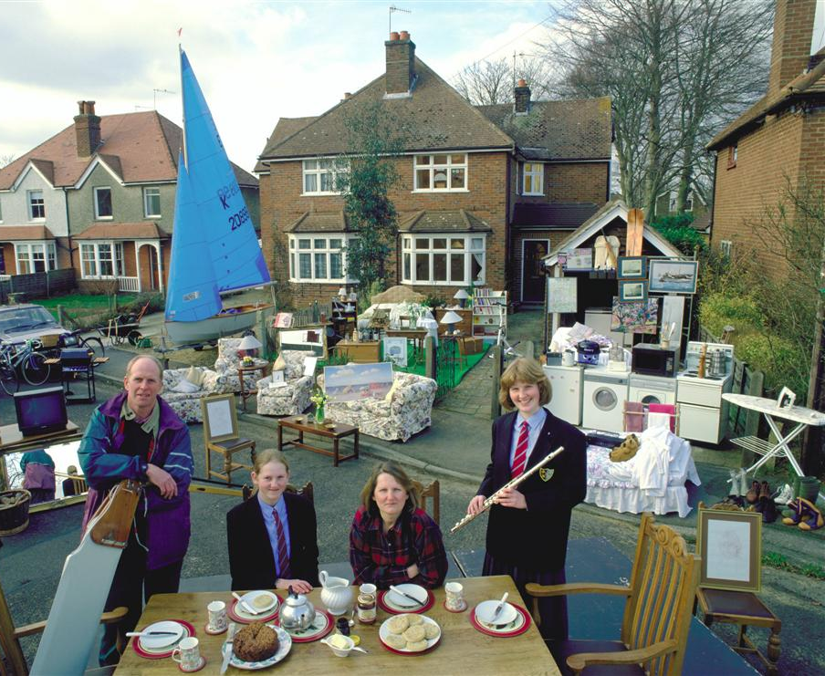
A typical family with all their possessions in the U.K., an advanced economy
Real GDP per capita: $30,800
Life expectancy: 78 years
Adult literacy: 99%
Notes:
This and the next two slides are from a new FYI box in the 4th edition, entitled “A Picture is Worth A Thousand Statistics.” These photos put a human face on the statistics and theories. Many students connect to these pictures more than to the data in Table 25-1.
For each picture, the family was paid to drag all of its stuff outside for the photo.
Before revealing the statistics in the lower left-hand corner, let your students soak in the picture for a moment. Point out some of the lovely things the family owns – the sailboat, the house with two chimneys and two bay windows in front, the state-of-the-art washer/dryer, and so forth.
Data sources:
Real GDP per capita is in PPP, 2004. Source: World Development Indicators, World Bank.
Life expectancy at birth, 2003. Source: World Development Indicators, World Bank.
For the UK, adult literacy is defined as the % of the population aged 15 and above with 5 or more years of schooling. The figure is from 2000. Source: CIA World Factbook, http://www.odci.gov/cia/publications/factbook/index.html

Slide 4

A typical family with all their possessions in Mexico, a middle income country
Real GDP per capita: $9,800
Life expectancy: 74 years
Adult literacy: 92%
Notes:
Again, let your students have a good look at the photo before revealing the statistics in the lower left corner. This family seems comfortable, but they don’t have quite as much stuff as the British family. No sailboat. No house with bay windows.
But they’re not doing so bad. To many students (especially in America), an income of $10,000 seems incredibly poor. But relative to the rest of the world, it’s not so bad.
Data sources:
Real GDP per capita is in PPP, 2004. Source: World Development Indicators, World Bank.
Life expectancy at birth, 2003. Source: World Development Indicators, World Bank.
Adult literacy is % of the population aged 15 and above that can read and write. The figure is from 2003. Source: CIA World Factbook, http://www.odci.gov/cia/publications/factbook/index.html

Slide 5
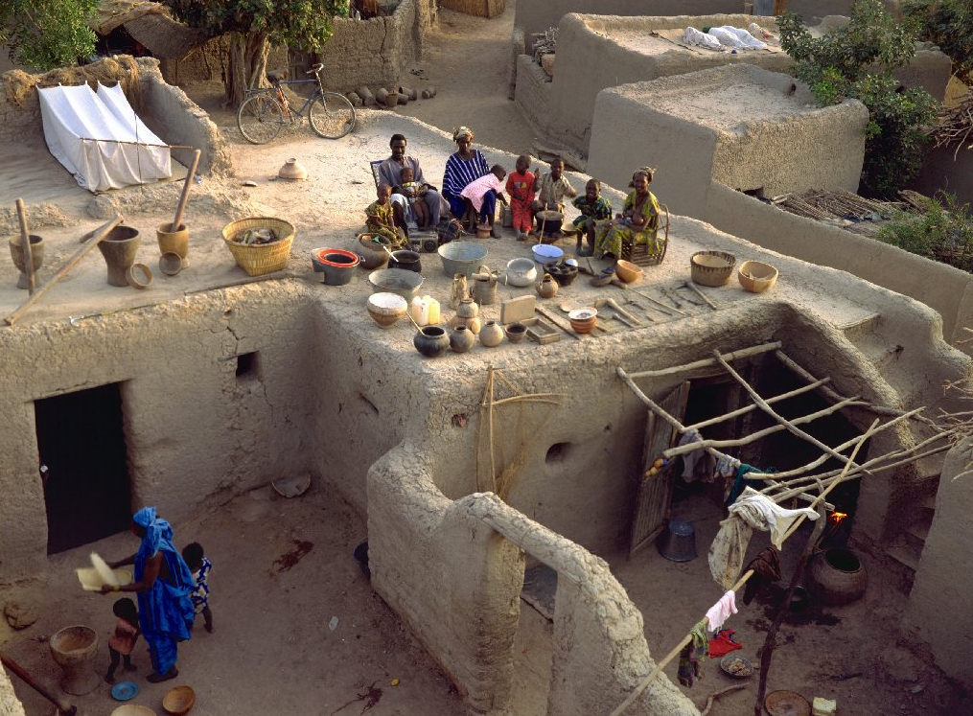
A typical family with all their possessions in Mali, a poor country
Real GDP per capita: $1,000
Life expectancy: 41 years
Adult literacy: 46%
Notes:
Here, the photo really is worth a thousand words. Look at the family’s possessions. Pottery, a few sticks, some clothing, and a dwelling that does not appear to have running water or climate control. That’s it. No sailboat, no upholstered furniture, no bicycles. This family is poor.
Now look at the statistics - $1000 income per capita? Heck, I spend that much on Starbucks drinks each year. Life expectancy is just over half what it is in the rich countries. And less than half the population can read or write their own language – most students can readily grasp that it’s hard to grow out of poverty if over half of the population is illiterate.
Data sources:
Real GDP per capita is in PPP, 2004. Source: World Development Indicators, World Bank.
Life expectancy at birth, 2003. Source: World Development Indicators, World Bank.
Adult literacy is % of the population aged 15 and above that can read and write. The figure is from 2003. Source: CIA World Factbook, http://www.odci.gov/cia/publications/factbook/index.html

Slide 6
Incomes and Growth Around the World
 | GDP per capita, 2004 | Growth rate, 1960-2004
China | $5,495 | 5.6%
Singapore | 27,273 | 5.4%
Japan | 29,539 | 3.9%
Spain | 25,341 | 3.2%
Israel | 24,082 | 2.6%
India | 3,115 | 2.5%
United States | 39,618 | 2.2%
Canada | 31,129 | 2.1%
Colombia | 7,121 | 1.8%
New Zealand | 22,912 | 1.4%
Philippines | 4,558 | 1.3%
Argentina | 12,723 | 0.8%
Saudi Arabia | 14,022 | 0.8%
Rwanda | 1,326 | 0.2%
Haiti | 1,685 | –1.3%
FACT 1:
There are vast differences in living standards around the world.
Notes:
Source: World Development Indicators, World Bank.
GDP per capita is in PPP$. “Growth rate” is the average annual growth rate of real GDP per capita (local currency), computed as
{ln(2004 value)-ln(1960 value)}/44
This table is similar to Table 1 in the textbook. There are two differences.
First, the set of countries is slightly different. I have excluded Mexico and the U.K., because they (and data on their GDP per capita) were featured in the photos. I have excluded Germany, because unification there makes earlier data not comparable with recent data, and thus complicates the calculation of the growth rate. Other countries from Table 1 excluded here are Brazil, Indonesia, Pakistan, and Bangladesh. The table on this slide includes the following countries, which do not appear in Table 1: Singapore, Spain (I wanted at least one country from Europe), Israel (it’s in the news often), Saudi Arabia (I wanted at least one OPEC country), Colombia (they make good coffee there, plus I wanted a couple countries from S. America), New Zealand (Oceania’s representative here), the Philippines, Rwanda and Haiti (representative poor countries, different from Table 1 just for variety).
Second, growth rates here are computed over 1960-2004 (except Canada, which is 1965-2004).
The purpose of this table (and of Table 1 in the text) is to convey the following two facts:
1) There are great differences in the standard of living across countries.
2) There are great differences in the growth rates across countries.
A corollary is that the rankings of countries can change over time: Countries at the bottom need not remain there – witness Japan and China, both of whom were far poorer in 1960.

Slide 7
Incomes and Growth Around the World
 | GDP per capita, 2004 | Growth rate, 1960-2004
China | $5,495 | 5.6%
Singapore | 27,273 | 5.4%
Japan | 29,539 | 3.9%
Spain | 25,341 | 3.2%
Israel | 24,082 | 2.6%
India | 3,115 | 2.5%
United States | 39,618 | 2.2%
Canada | 31,129 | 2.1%
Colombia | 7,121 | 1.8%
New Zealand | 22,912 | 1.4%
Philippines | 4,558 | 1.3%
Argentina | 12,723 | 0.8%
Saudi Arabia | 14,022 | 0.8%
Rwanda | 1,326 | 0.2%
Haiti | 1,685 | –1.3%
FACT 2:
There is also great variation in growth rates across countries.

Slide 8
Incomes and Growth Around the World
Since growth rates vary, the country rankings can change over time:
Poor countries are not necessarily doomed to poverty forever – e.g., Singapore, incomes were low in 1960 and are quite high now.
Rich countries can’t take their status for granted: They may be overtaken by poorer but faster-growing countries.

Slide 9
Incomes and Growth Around the World
Questions:
Why are some countries richer than others?
Why do some countries grow quickly while others seem stuck in a poverty trap?
What policies may help raise growth rates and long-run living standards?
Notes:
The preceding data gives rise to these important questions, which this chapter addresses next.

Slide 10
Productivity
Recall one of the Ten Principles from Chapter 1: A country’s standard of living depends on its ability to produce g & s.
This ability depends on productivity: the average quantity of g&s produced per unit of labor input.
Y = real GDP = quantity of output produced L = quantity of labor so we can write productivity as Y/L (output per worker)
Notes:
As in previous chapters, “g&s” is short for “goods and services.”

Slide 11
Why Productivity Is So Important
When a nation’s workers are very productive, real GDP is large and incomes are high.
When productivity grows rapidly, so do living standards.
What, then, determines productivity and its growth rate?

Slide 12
Physical Capital Per Worker
Recall: The stock of equipment and structures used to produce g&s is called [physical] capital, denoted K.
K/L = capital per worker.
Productivity is higher when the average worker has more capital (machines, equipment, etc.).
i.e., an increase in K/L causes an increase in Y/L.
Notes:
It is common to refer to physical capital as just “capital,” hence the brackets around “physical.” Here, though, the distinction is important, because the following slide discusses human capital.
The last bullet point on this slide dovetails into the FYI box on the production function (which, in this powerpoint presentation, follows the determinants of productivity). If you are not covering that material, you can delete the last bullet point.

Slide 13
Human Capital Per Worker
Human capital (H): the knowledge and skills workers acquire through education, training, and experience
H/L = the average worker’s human capital
Productivity is higher when the average worker has more human capital (education, skills, etc.).
i.e., an increase in H/L causes an increase in Y/L.
Notes:
Again, if you’re not going to cover the production function, you can safely delete the last bullet point.

Slide 14
Natural Resources Per Worker
Natural resources (N): the inputs into production that nature provides, e.g., land, mineral deposits
Other things equal, more N allows a country to produce more Y.
In per-worker terms, an increase in N/L causes an increase in Y/L.
Some countries are rich because they have abundant natural resources (e.g., Saudi Arabia has lots of oil)
But countries need not have much N to be rich (e.g., Japan imports the N it needs).

Slide 15
Technological Knowledge
Technological knowledge: society’s understanding of the best ways to produce g&s
Technological progress does not only mean a faster computer, a higher-definition TV, or a smaller cell phone.
It means any advance in knowledge that boosts productivity (allows society to get more output from its resources).
e.g., Henry Ford and the assembly line.
Notes:
This definition of technology is more broad than what most people think of as technology. To most people, improvements in technology mean a smaller cell phone, a faster computer, a higher-definition television set, an MP3 player that can hold more songs, and so forth.
But “technology” doesn’t just mean computer-related stuff. Technology refers to the knowledge that allows producers to transform inputs into output.
Here’s an important example of technological progress that doesn’t involve computers at all: Henry Ford discovered that he could boost productivity in his auto factory simply by rearranging the workers and machines, and reassigning the workers’ tasks.
(Interesting trivia: While Henry Ford is famous for introducing the assembly line in 1913, did you know that the idea was already over 100 years old? In 1799, Eli Whitney introduced assembly line production into the manufacture of muskets for the U.S. Government. Whitney was famous for inventing the cotton gin, but his discovery of the assembly line has had a far greater impact on productivity and living standards in the U.S.)

Slide 16
Tech. Knowledge vs. Human Capital
Technological knowledge refers to society’s understanding of how to produce g&s.
Human capital results from the effort people expend to acquire this knowledge.
Both are important for productivity.
Notes:
You might also add that technological knowledge can easily be shared among infinitely many producers. Human capital is generally tied to the individuals that expend the effort to acquire it.
For example, if someone discovers a more cost-effective way to manufacture cars, this knowledge can be shared with all auto manufacturers, causing a general increase in productivity in the auto sector. If someone acquires some skills or experience that enable him or her to do his or her job better, then his productivity rises, but not that of all persons in his occupation.

Slide 17
The Production Function
The production function is a graph or equation showing the relation between output and inputs:
Y = A F(L, K, H, N)
F( ) – a function that shows how inputs are combined to produce output
“A” – the level of technology
“A” multiplies the function F( ), so improvements in technology (increases in “A”) allow more output (Y) to be produced from any given combination of inputs.
Notes:
This and the following two slides cover material in an FYI box. If you wish, you can safely omit these slides without loss of continuity.
Students may wonder why the technology variable (A) is multiplying the F( ) function rather than inside it. For now, tell them only inputs go inside the F( ) function. Ask them to wait until you show them the following slide, where it may be easier to see why we treat “A” differently than the other determinants of productivity.

Slide 18
The Production Function
Y = A F(L, K, H, N)
The production function has the property constant returns to scale: Changing all inputs by the same percentage causes output to change by that percentage. For example,
Doubling all inputs (multiplying each by 2) causes output to double:
2Y = A F(2L, 2K, 2H, 2N)
Increasing all inputs 10% (multiplying each by 1.1) causes output to increase by 10%:
1.1Y = A F(1.1L, 1.1K, 1.1H, 1.1N)
Notes:
Point out to students that we are only multiplying the INPUTS by 2. We are not multiplying the technology variable (“A”) by 2.

Slide 19
The Production Function
Y = A F(L, K, H, N)
If we multiply each input by 1/L, then output is multiplied by 1/L:
Y/L = A F(1, K/L, H/L, N/L)
This equation shows that productivity (output per worker) depends on:
the level of technology (A)
physical capital per worker
human capital per worker
natural resources per worker
Notes:
Why “1” is inside the production function:
Students may wonder what the number “1” is doing inside the F( ) function. On the preceding slide, the aggregate production function was written as Y = A F(L, K, H, N). We multiplied all of the inputs by 1/L, and because of constant returns to scale, output is also multiplied by 1/L:
Y/L = A F(L/L, K/L, H/L, N/L)
The first term in the F( ) function is L/L, which just equals 1.
Read literally, this equation says that output per worker depends on technology, the number of workers per worker, the amount of physical and human capital per worker, and natural resources per worker. But the number of workers per worker is always 1.
Why “A” is outside the production function:
What matters for productivity is not “technical knowledge per worker” but simply “technological knowledge.” Unlike physical capital or other resources, technological knowledge can be freely shared among all workers. If the number of workers increases, you must purchase new capital for the new workers (or spread the existing capital more thinly), but technological knowledge can be freely shared with the new workers.

Slide 20
A C T I V E L E A R N I N G 1: Discussion question
Which of the following policies do you think would be most effective at boosting growth and living standards in a poor country over the long run?
offer tax incentives for investment by local firms
…by foreign firms
give cash payments for good school attendance
crack down on govt corruption
restrict imports to protect domestic industries
allow free trade
give away condoms
19
Notes:
Budget about 10 minutes of class time for this activity. If you cannot afford ten minutes, delete a few of the policy choices to narrow of the focus of the discussion.
Suggested instructions: Display the question and read off the policy options (briefly elaborating on any of them if you feel appropriate). Tell students that there is no single correct answer, and that all feedback is welcome. Give students a moment to decide, then take a vote. Make a note of the number of votes each policy receives.
Start with the policy option that received the most votes. Ask 1 or 2 students that voted for this option to explain why they voted for it. Next, do the same for the option that received the second largest number of votes, or any other policy choice you wish to discuss.
This activity has several objectives. First, it breaks up the lecture with a brief discussion activity that engages students. Second, it puts students in a frame of mind that makes them more receptive to the material that follows – namely, the different ways that policy can affect the determinants of productivity, economic growth, and living standards.
Third, it gives you some quick assessment of student comprehension. When students explain why they voted for particular policies, you will see whether their explanations reflect an attempt to apply the concepts covered so far in this presentation. For example, suppose a student says she voted for policy (a) because more investment raises capital per worker, which raises productivity and living standards. This student has successfully applied the concepts covered earlier in your presentation.
Alternatively, suppose you get several responses like the following: “I voted for (a) because I think it’s better for the country to retain control of their own factories, rather than letting multinationals like Nike own the factories.” A response like this is an example of “thinking outside the box” – answering the question based NOT on the material covered so far, but on impressions students have formed from reading the newspaper or watching the evening news or “60 Minutes.”
After you get several such responses, you might tell students something like this: “Many of your responses are how a typical, intelligent, college-educated person might answer this question. However, what you should try to do is to ‘think INSIDE the box’ – i.e., answer the question based strictly on the material covered in this chapter. Here, ‘the box’ is the model I’ve just presented, which says that living standards are determined by productivity, and productivity is determined by capital per worker, human capital per worker, natural resources per worker, and technology. So your objective is to think of how each policy affects these determinants. That is what we’ll discuss in the remainder of this chapter. As we go over this material next, see how the policy you voted for affects productivity or its growth rate.”

Slide 21
ECONOMIC GROWTH AND PUBLIC POLICY
Next, we look at the ways public policy can affect long-run growth in productivity and living standards.

Slide 22
Saving and Investment
We can boost productivity by increasing K, which requires investment.
Since resources scarce, producing more capital requires producing fewer consumption goods.
Reducing consumption = increasing saving. This extra saving funds the production of investment goods. (More details in the next chapter.)
Hence, a tradeoff between current and future consumption.
Notes:
Remember one of the 10 principles: people face tradeoffs. The tradeoff between current and future consumption is a good example of one.

Slide 23
Diminishing Returns and the Catch-Up Effect
The govt can implement policies that raise saving and investment. (Details in next chapter.) Then K will rise, causing productivity and living standards to rise.
But this faster growth is temporary, due to diminishing returns to capital: As K rises, the extra output from an additional unit of K falls….

Slide 24
The Production Function & Diminishing Returns
Y/L
If workers have little K, giving them more increases their productivity a lot.
Output per worker (productivity)
If workers already have a lot of K, giving them more increases productivity fairly little.
K/L
Capital per worker
Notes:
This slide replicates Figure 1 from the text, a new figure in the 4th edition which illustrates the relationship between productivity (output per worker) and one of its determinants: capital per worker.
The curve is drawn for given values of the other determinants of productivity (human capital per worker, natural resources per worker, technology). A change in any of these other determinants would shift the curve.
The graph is positively sloped: productivity is higher when the average worker has more capital.
The graph is curved, reflecting diminishing returns to capital: as the average worker gets more and more capital, productivity rises at a decreasing rate. Students may find it easier to understand the following statement (especially if this is their first course in economics): If workers don’t have very much capital, giving them more will increase their productivity a lot. If workers already have a lot of capital, giving them more won’t increase their productivity very much.

Slide 25
The catch-up effect:
the property whereby poor countries tend to grow more rapidly than rich ones
Y/L
Rich country’s growth
Poor country’s growth
K/L
Poor country starts here
Rich country starts here
Notes:
Notice that K/L increases by the same amount in both countries. But thanks to diminishing returns, the increase in K/L has a bigger effect in the poor country than in the rich country.
As a result, the poor country enjoys a higher growth rate than the rich country, and the gap between them shrinks over time. In the literature, this is known as “convergence.” In this principles-level book, it is called the “catch-up effect.”
In order for the catch-up effect to work, it must be true that both countries have the same technology and hence production function. If the poor country has inferior technology, its production function will be lower; then, it won’t necessarily grow faster than the rich one, and the gap won’t necessarily shrink over time.

Slide 26
Example of the Catch-Up Effect
Over 1960-1990, the U.S. and S. Korea devoted a similar share of GDP to investment, so you might expect they would have similar growth performance.
But growth was >6% in Korea and only 2% in the U.S.
Explanation: the catch-up effect. In 1960, K/L was far smaller in Korea than in the U.S., hence Korea grew faster.

Slide 27
Investment from Abroad
To raise K/L and hence productivity, wages, and living standards, the govt can also encourage
Foreign direct investment: a capital investment (e.g., factory) that is owned & operated by a foreign entity.
Foreign portfolio investment: a capital investment financed with foreign money but operated by domestic residents.
Some of the returns from these investments flow back to the foreign countries that supplied the funds.

Slide 28
Investment from Abroad
Especially beneficial in poor countries that cannot generate enough saving to fund investment projects themselves.
Also helps poor countries learn state-of-the-art technologies developed in other countries.

Slide 29
Education
Govt can increase productivity by promoting education–investment in human capital (H).
public schools, subsidized loans for college
Education has significant effects: In the U.S., each year of schooling raises a worker’s wage by 10%.
But investing in H also involves a tradeoff between the present & future: Spending a year in school requires sacrificing a year’s wages now to have higher wages later.
Notes:
The 4th edition of the textbook has an excellent new In the News box, entitled “Promoting Human Capital.” It contains a 2004 New York Times article on a policy Brazil has implemented which gives families cash payments if their children attend school faithfully. Other developing countries have similar policies, which experts predict will raise productivity and living standards in the long run.

Slide 30
Health and Nutrition
Health care expenditure is a type of investment in human capital – healthier workers are more productive.
In countries with significant malnourishment, raising workers’ caloric intake raises productivity:
Over 1962-95, caloric consumption rose 44% in S. Korea, and economic growth was spectacular.
Nobel winner Robert Fogel: 30% of Great Britain’s growth from 1790-1980 was due to improved nutrition.
Notes:
This section is brand-new to the 4th edition.
You might want to point out that the positive correlations between living standards and education or health & nutrition could result from causality in either direction:
Investing in human capital – either through education or improving health & nutrition – can indeed lead to higher incomes in the long run. But it is equally true that countries with higher incomes can afford to devote more resources to schooling or improving health & nutrition.

Slide 31
Property Rights and Political Stability
Recall: Markets are usually a good way to organize economic activity. The price system allocates resources to their most efficient uses.
This requires respect for property rights, the ability of people to exercise authority over the resources they own.

Slide 32
Property Rights and Political Stability
In many poor countries, the justice system doesn’t work very well:
contracts aren’t always enforced
fraud, corruption often go unpunished
in some, firms must bribe govt officials for permits
Political instability (e.g., frequent coups) creates uncertainty over whether property rights will be protected in the future.

Slide 33
Property Rights and Political Stability
When people fear their capital may be stolen by criminals or confiscated by a corrupt govt, there is less investment, including from abroad, and the economy functions less efficiently. Result: lower living standards.
Economic stability, efficiency, and healthy growth require law enforcement, effective courts, a stable constitution, and honest govt officials.

Slide 34
Free Trade
Inward-oriented policies (e.g., tariffs, limits on investment from abroad) aim to raise living standards by avoiding interaction with other countries.
Outward-oriented policies (e.g., the elimination of restrictions on trade or foreign investment) promote integration with the world economy.

Slide 35
Free Trade
Recall: Trade can make everyone better off.
Trade has similar effects as discovering new technologies – it improves productivity and living standards.
Countries with inward-oriented policies have generally failed to create growth.
e.g., Argentina during the 20th century.
Countries with outward-oriented policies have often succeeded.
e.g., South Korea, Singapore, Taiwan after 1960.
Notes:
The 4th edition contains a new “In the News” box called “Rich Farmers vs. the World’s Poor.” It contains an op-ed piece by the presidents of two poor countries entitled “Your Farm Subsidies Are Strangling Us.” It is an excellent article – please encourage your students to read it carefully. (One way to do this is announce that the next exam will contain questions on this article.)
Incidentally, this article is also excellent for use when teaching the chapter entitled “Application: International Trade,” which uses the tools of welfare economics to assess trade and trade policy. This chapter appears as Chapter 9 of every version of this textbook except Brief Principles of Macroeconomics.

Slide 36
Research and Development
Technological progress is the main reason why living standards rise over the long run.
One reason is that knowledge is a public good: Ideas can be shared freely, increasing the productivity of many.
Policies to promote tech. progress:
patent laws
tax incentives or direct support for private sector R&D
grants for basic research at universities

Slide 37
Population Growth
…may affect living standards in 3 different ways:
1. Stretching natural resources
200 years ago, Malthus argued that pop. growth would strain society’s ability to provide for itself.
Since then, the world population has increased sixfold. If Malthus was right, living standards would have fallen. Instead, they’ve risen.
Malthus failed to account for technological progress and productivity growth.

Slide 38
Population Growth
2. Diluting the capital stock
more population = higher L = lower K/L = lower productivity & living standards.
This applies to H as well as K: fast pop. growth = more children = greater strain on educational system.
Countries with fast pop. growth tend to have lower educational attainment.

Slide 39
Population Growth
2. Diluting the capital stock
To combat this, many developing countries use policy to control population growth.
China’s one child per family laws
contraception education & availability
promote female literacy to raise opportunity cost of having babies

Slide 40
Population Growth
3. Promoting tech. progress
More people
= more scientists, inventors, engineers
= more frequent discoveries
= faster tech. progress & economic growth
Evidence from Michael Kremer: Over the course of human history,
growth rates increased as the world’s population increased
more populated regions grew faster than less populated ones
Notes:
The textbook cites research by Michael Kremer published in the 1993 Quarterly Journal of Economics.

Slide 41
A C T I V E L E A R N I N G 2: Productivity
List the determinants of productivity.
List three policies that attempt to raise living standards by increasing one of the determinants of productivity.
40
Notes:
This activity serves as a quick check of students’ comprehension of the material in this chapter.
It’s also interesting to see whether their policy suggestions here reveal any improvement in learning over the discussion of policies in Active Learning 1, above.

Slide 42
A C T I V E L E A R N I N G 2: Answers
Determinants of productivity: physical capital per worker (K/L) human capital per worker (H/L) natural resources per worker (N/L) technological knowledge (A)
Policies to boost productivity:
Encourage saving and investment, to raise K/L
Encourage investment from abroad, to raise K/L
Provide public education, to raise H/L
41

Slide 43
A C T I V E L E A R N I N G 2: Answers
Determinants of productivity: physical capital per worker (K/L) human capital per worker (H/L) natural resources per worker (N/L) technological knowledge (A)
Policies to boost productivity:
Patent laws or grants, to increase A
Control population growth, to increase K/L
42
Notes:
Students may name other policies, such as:
(1) promote free trade or pursue outward-oriented trade policies
(2) crack down on corruption or otherwise protect and enforce property rights
Based on the discussion in this chapter, it may not be obvious which of the determinants of productivity these policies affect. I think a case could be made that (1) and (2) affect “A” (boosting economic efficiency) and that (2) also affects K/L.

Slide 44
Are Natural Resources a Limit to Growth?
Some argue that population growth is depleting the Earth’s non-renewable resources, and thus will limit growth in living standards.
But technological progress often yields ways to avoid these limits:
Hybrid cars use less gas.
Better insulation in homes reduces the energy required to heat or cool them.
As a resource becomes scarcer, its market price rises, which increases the incentive to conserve it and develop alternatives.
Notes:
I moved this case study from the middle of the chapter to the end of this PowerPoint presentation. Feel free to move it back if you wish.
Due to space constraints, the last bullet point is a bit different than the corresponding material in the textbook. The textbook argues the following:
In a market economy, scarcity is reflected in market prices. If the world were running out of natural resources, the prices of those resources would be rising over time. But, in fact, they are not. The prices of most natural resources (in real terms) are stable or falling. It appears that our ability to conserve these resources is growing more rapidly than their supplies are dwindling.

Slide 45
CONCLUSION
In the long run, living standards are determined by productivity.
Policies that affect the determinants of productivity will therefore affect the next generation’s living standards.
One of these determinants is saving and investment.
In the next chapter, we will learn how saving and investment are determined, and how policies can affect them.
Notes:
This slide alludes to the chapter entitled “Saving, Investment, and the Financial System,” which immediately follows the current chapter. If you will not be covering that chapter, then you should delete or edit this slide.

Slide 46
CHAPTER SUMMARY
There are great differences across countries in living standards and growth rates.
Productivity (output per unit of labor) is the main determinant of living standards in the long run.
Productivity depends on physical and human capital per worker, natural resources per worker, and technological knowledge.
Growth in these factors – especially technological progress – causes growth in living standards over the long run.

Slide 47
CHAPTER SUMMARY
Policies can affect the following, each of which has important effects on growth:
saving and investment
international trade
education, health & nutrition
property rights and political stability
research and development
population growth
Because of diminishing returns to capital, growth from investment eventually slows down, and poor countries may “catch up” to rich ones.

